Slide 1
V HACKATHON 2020

Slide 2

Group Details
Team Name : CMPN-100
Group Members
Abhishek Phalak Piyush Patil Siddharth Pawar Tanya Dwivedi

Slide 3
Problem Statement
It has become very important for E-commerce organizations to know what their customers think about their products. Knowing this data is crucial for the organizations to change their business as required. Build a web based dashboard to display sentiments by analysing raw customer feedback in review for products.

Slide 4
Approach towards Problem
Analyse the sentiments using ML to verify feedback being negative or positive and visualize it further using pie charts etc. to provide the institution with feedback given by users
Choose a data set about a particular product
5
1
4
Develop UI where the website will contain the information about the product and the company and a button for user to provide feedback
Split the data into train and test, and train the data using the ML to classify or use sentiment analysis to categorize into positive or negative feedback
2
3
Improve the prediction accuracy as much as possible

Slide 5
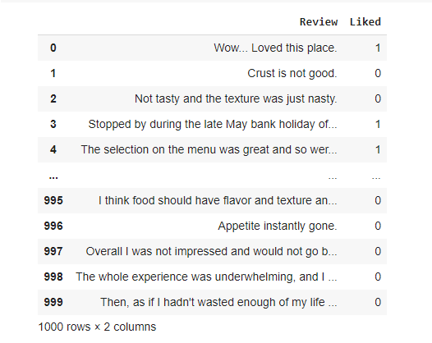
Context:
Most of the restaurants ask reviews to the customers and improve the customer satisfaction based on them. Thus, reviews play a vital role for growth of the restaurant.
Content:
The data set consists of 1000 rows and 2 columns. ‘Review’ column consists of the customer reviews and like column consists of 0 and 1. 1 indicates a positive review whereas 0 indicates a negative one.

Slide 6
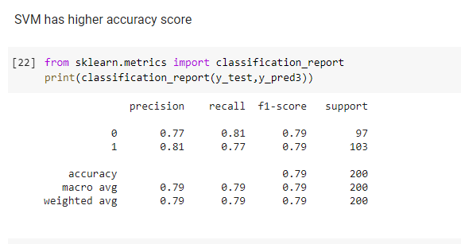
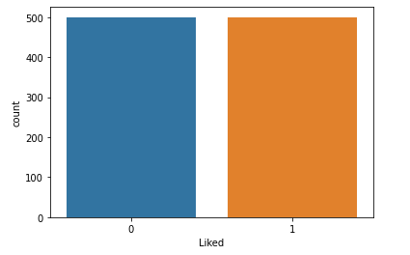
Test Data Predictions

Slide 7
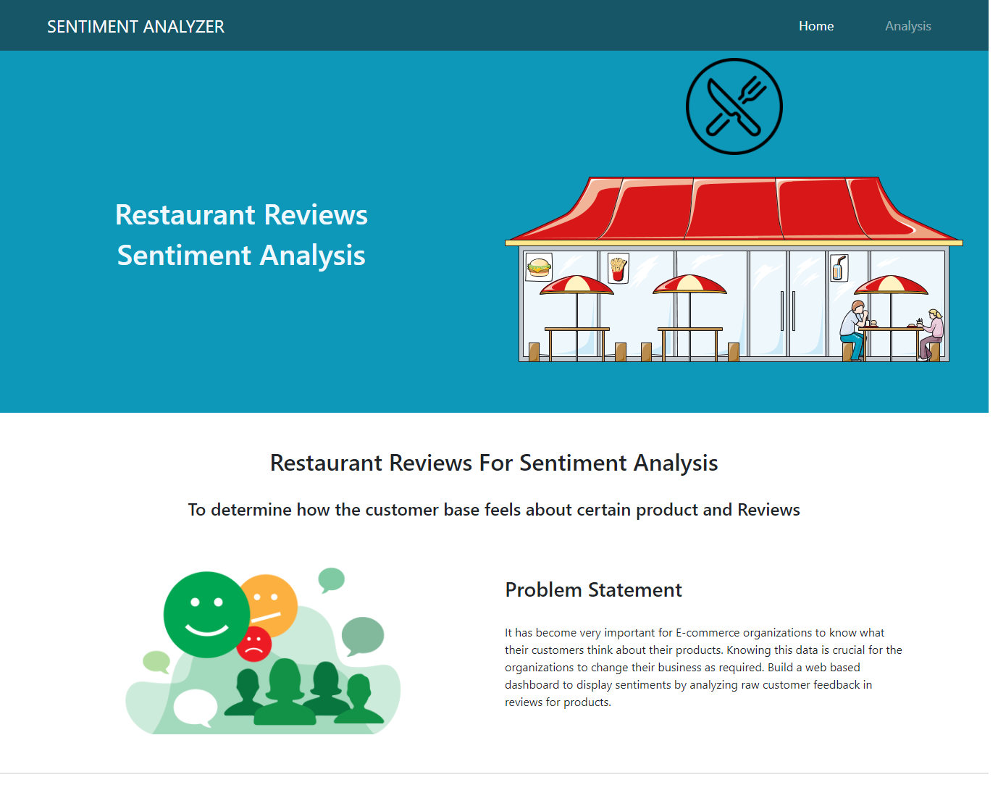
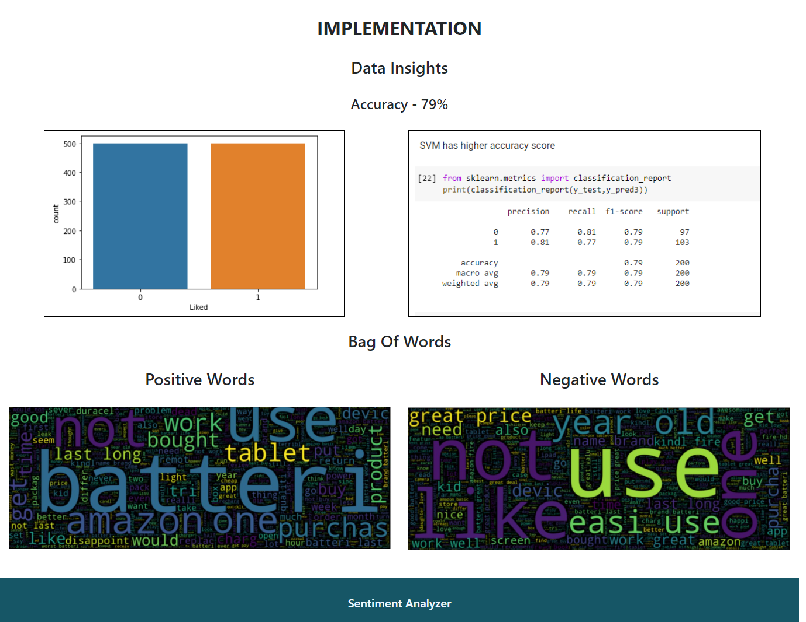

Slide 8
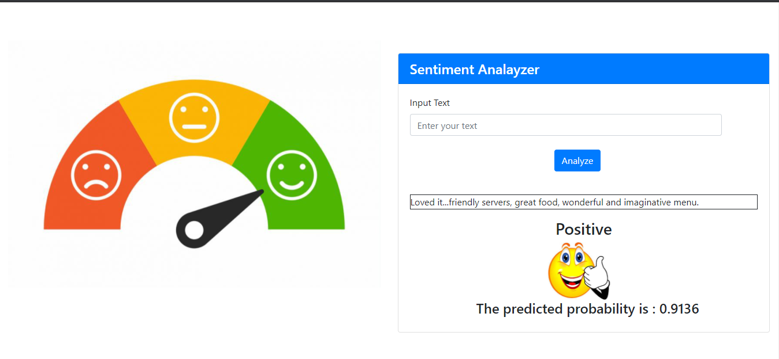
SENTIMENT ANALYSIS OF CUSTOMER REVIEWS

Slide 9
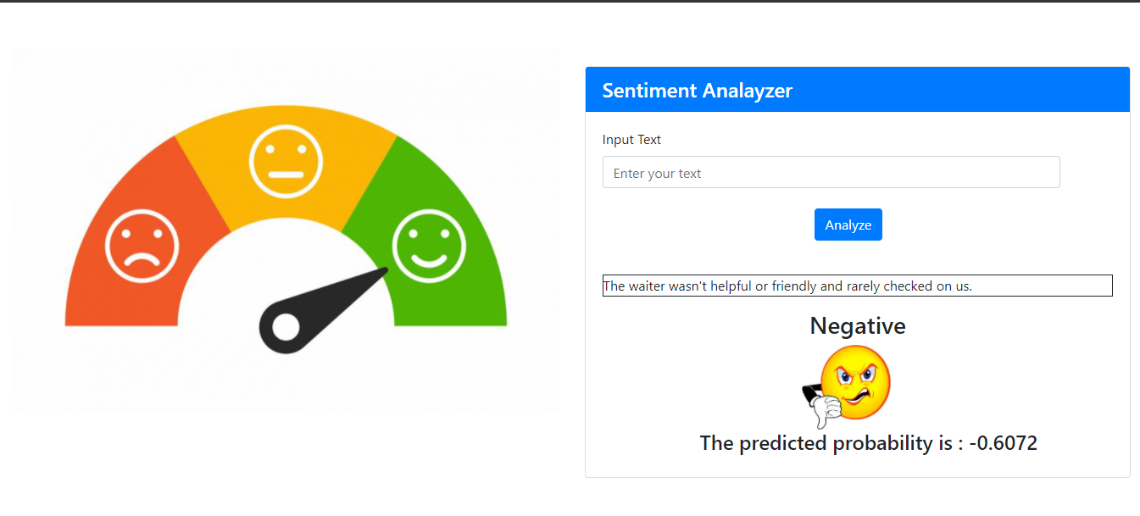
SENTIMENT ANALYSIS OF CUSTOMER REVIEWS

